Slide 1
19CSE211 Computer Architecture & Organization
Arithmetic Operation – Part 2

Slide 2
Divide: Paper & Pencil
1001 Quotient
Divisor 1000 1001010 Dividend –1000 10 101 1010 –1000 10 Remainder (or Modulo result)
Dividend = Quotient × Divisor + Remainder

Slide 3
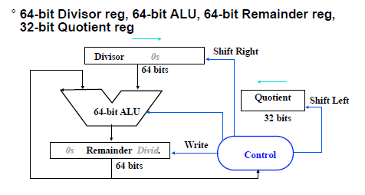
Restoring division hardware Divisor on the left half of Divisor reg Dividend on the right half of Rem reg

Slide 4
Divide Algorithm - 1
Start: Place Dividend in Remainder
Takes n+1 steps for n-bit Quotient & Rem.
Remainder Quotient Divisor 0000 0111 0000 0010 0000
1. Subtract the Divisor register from the
Remainder register, and place the result
in the Remainder register.
Remainder ≥ 0
Test Remainder
Remainder < 0
2a. Shift the
Quotient register
to the left setting
the new rightmost
bit to 1.
2b. Restore the original value by adding the
Divisor register to the Remainder register, &
place the sum in the Remainder register. Also
shift the Quotient register to the left, setting
the new least significant bit to 0.
3. Shift the Divisor register right1 bit.
n+1
repetition?
No: < n+1 repetitions
Yes: n+1 repetitions (n = 4 here)
Done
Notes:
Q: 0000 D: 0010 0000 R: 0000 0111 –D = 1110 0000
1: R = R–D Q: 0000 D: 0010 0000 R: 1110 0111
2b: +D, sl Q, 0 Q: 0000 D: 0010 0000 R: 0000 0111
3: Shr D Q: 0000 D: 0001 0000 R: 0000 0111 –D = 1111 0000
1: R = R–D Q: 0000 D: 0001 0000 R: 1111 0111
2b: +D, sl Q, 0 Q: 0000 D: 0001 0000 R: 0000 0111
3: Shr D Q: 0000 D: 0000 1000 R: 0000 0111 –D = 1111 1000
1: R = R–D Q: 0000 D: 0000 1000 R: 1111 1111
2b: +D, sl Q, 0 Q: 0000 D: 0000 1000 R: 0000 0111
3: Shr D Q: 0000 D: 0000 0100 R: 0000 0111 –D = 1111 1100
1: R = R–D Q: 0000 D: 0000 0100 R: 0000 0011
2a: sl Q, 1 Q: 0001 D: 0000 0100 R: 0000 0011
3: Shr D Q: 0000 D: 0000 0010 R: 0000 0011 –D = 1111 1110
1: R = R–D Q: 0000 D: 0000 0010 R: 0000 0001
2a: sl Q, 1 Q: 0011 D: 0000 0010 R: 0000 0001
3: Shr D Q: 0011 D: 0000 0001 R: 0000 0001
Recommend show 2’s comp of divisor, show lines for subtract divisor and restore remainder

Slide 5
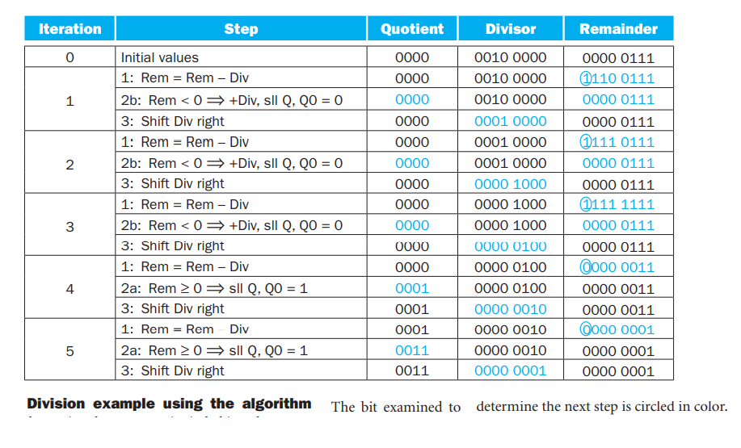
Example

Slide 6
Divide Algorithm I example (7 / 2)
Remainder Quotient Divisor 0000 0111 00000 0010 0000
1: 1110 0111 00000 0010 0000
2: 0000 0111 00000 0010 0000
3: 0000 0111 00000 0001 0000
1: 1111 0111 00000 0001 0000
2: 0000 0111 00000 0001 0000
3: 0000 0111 00000 0000 1000
1: 1111 1111 00000 0000 1000
2: 0000 0111 00000 0000 1000
3: 0000 0111 00000 0000 0100
1: 0000 0011 00000 0000 0100
2: 0000 0011 00001 0000 0100
3: 0000 0011 00001 0000 0010
1: 0000 0001 00001 0000 0010
2: 0000 0001 00011 0000 0010
3: 0000 0001 00011 0000 0001
Answer:
Quotient = 3
Remainder = 1
Instead of shifting divisor to right, shift remainder to left?

Slide 7
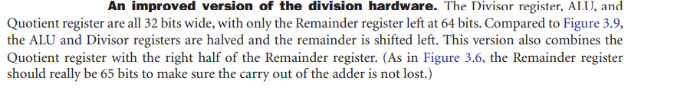
DIVIDE HARDWARE 2
32-bit Divisor reg, 32 -bit ALU, 64-bit Remainder reg, (0-bit Quotient reg)
Divisor
32 bits
32-bit ALU
“HI”
“LO”
Shift Left
Remainder
(Quotient)
Control
64 bits
Write

Slide 8
Divide Algorithm 2
Step Remainder Div. 0 0000 0111 0010
1.1 0000 1110
1.2 1110 1110
1.3b 0001 1100
2.2 1111 1100
2.3b 0011 1000
3.2 0001 1000
3.3a 0011 0001
4.2 0001 0001
4.3a 0010 0011
0001 0011
Start: Place Dividend in Remainder
1. Shift the Remainder register left 1 bit.
2. Subtract the Divisor register from the left half of the Remainder register, & place the
result in the left half of the Remainder register.
Remainder ≥ 0
Test Remainder
Remainder < 0
3a. Shift the
Remainder register
to the left setting
the new rightmost
bit to 1.
3b. Restore the original value by adding the Divisor
register to the left half of the Remainder register,
&place the sum in the left half of the Remainder
register. Also shift the Remainder register to the
left, setting the new least significant bit to 0.
nth
repetition?
No: < n repetitions
Yes: n repetitions (n = 4 here)
Done. Shift left half of Remainder right 1 bit
Notes:
D: 0010 R: 0000 0111
0: Shl R D: 0010 R: 0000 1110
1: R = R–D D: 0010 R: 1110 1110
2b: +D, sl R, 0 D: 0010 R: 0001 1100
1: R = R–D D: 0010 R: 1111 1100
2b: +D, sl R, 0 D: 0010 R: 0011 1000
1: R = R–D D: 0010 R: 0001 1000
2a: sl R, 1 D: 0010 R: 0011 0001
1: R = R–D D: 0010 R: 0001 0001
2a: sl R, 1 D: 0010 R: 0010 0011
Shr R(rh) D: 0010 R: 0001 0011

